Slide 2


This presentation has been created by the Center for Cyber Safety and Education with the help of the world’s leading cybersecurity professionals: the certified global members of (ISC)².
Notes:
The Center for Cyber Safety and Education has created this presentation free of charge to further its mission of empowering children, parents, and senior citizens to secure their online life with cyber security education and awareness programs.
This presentation was created with the help of the world’s leading cybersecurity professionals: the certified members of (ISC)² (pronounced ISC Squared).
Let’s start with some basic information to help you understand the cyber world.

Slide 3


Expectations
Awareness
Notes:
Many of us have probably experienced something negative in our time using the internet and the rest of us have certainly heard about some scary things in the news when it comes to the online world. This has led to the unfortunate expectations of the internet being a hard place to navigate with hidden dangers around every corner. But, with awareness, this doesn’t have to be the case. While we need to be knowledgeable of the dangers, we don’t have to be fearful.
The goal of this presentation is not to scare you away from the internet, but to teach you to use it safely. Unfortunately, there are a lot of bad guys out there using the internet to prey on people. Like most things in life, the internet is going to be a lot less scary and dangerous with awareness and training.

Slide 4
About You Do you mostly ...
Connect with other people?
Bank and shop?
Watch movies and play games?
What else do you do?
Notes:
For many of us, the internet has become an important part of our lives. There are many benefits to using it like keeping up with family and friends, playing games, and learning new things. What do you do on the internet? Do you ever wonder why sometimes it seems like your children or grandchildren can use internet connected devices so easily while you sometimes struggle to check your e-mail or know which internet sites are safe to visit? Or how to bank safely? You certainly are not alone in this and there is an explanation.
Many of us were not born into today’s cyber world meaning we’re “Digital Immigrants.” But, today’s generation are considered “Digital Natives” since they were born into an interconnected world. The internet allows access to vast amounts of information where we can find nearly anything we can imagine. Unfortunately, the internet has also created a platform for criminal activity and a place where people can pretend to be anyone they want.
We will focus on a couple of key areas today including safe online interactions and device safety.
Let’s begin with a few basic terms to start surfing the internet safely.

Slide 5

UNDERSTANDING THE CYBERWORLD
Knowing basic terminology will help you navigate the internet safely
MALWARE
PHISHING
CLOUD
WIFI
APP
Notes:
The internet is a powerful and useful tool, but in the same way that you wouldn’t head out in your car without buckling your seat belt or ride a bike without a helmet, you shouldn’t venture online without taking some basic precautions. Learning about some of the existing threats can help you enjoy a safer, happier internet experience. We’ll go over these more in depth later, but you’ll be hearing about them while going through the presentation.
Malware is malicious software used to gain access to your computer. You’ve probably heard of the term “virus.” These are harmful computer programs. All are designed to spread themselves from one computer to another through the internet. Most commonly, they are designed to give the criminals who create them some sort of access to those computers to steal personal information. Phishing is an attempt from a criminal to steal your financial or personal information by pretending to be someone else and tricking you into clicking a malicious link or opening a malicious attachment.
The term “Cloud” is used to describe a remote service that can store your information for you like documents and pictures. In other words, you can store something in the cloud without having to take up room on your own computer.
You may have tried to access the internet outside of your home on a portable device like a phone, laptop, or tablet; perhaps at a hotel or coffee shop. You were accessing the wireless internet, or Wi-Fi. This is simply technology that allows you to connect to the internet without wires. Many of you have this set up in your home.
Speaking of those portable devices like phones and tablets, when you go to download something onto your phone like a game or social network, you are downloading an Application, or commonly referred to as an App.
First things first, lets start with possibly the single most important thing for you to remember today.

Slide 6
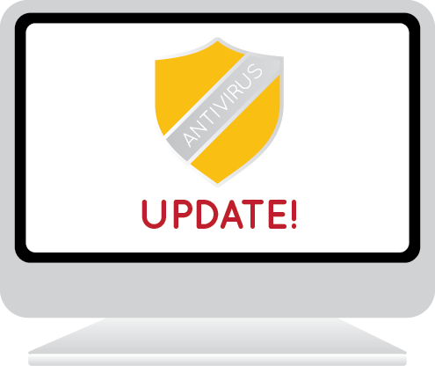
MALWARE PROTECTION
Get anti-virus and keep it updated!
Notes:
Always start with an anti-virus! You can access good and free anti-virus software or you can pay for one. Some of the free anti-virus software may not have as many advanced features as the paid ones but are still good options for malware protection. Your machine may have come with one when you bought it, or you can always go back to the store and get one. But, getting the anti-virus isn’t enough.
Your anti-virus software is only as good as you allow it to be. You’ve got to keep it updated. Programs on your computer, especially your anti-virus, need to be updated regularly. What does an update do? Every time a hacker finds a weak spot, the company sends out a patch to repair the hole. Updates can also install new features or fix simple problems. In most cases, you can set the anti-virus software to retrieve the updates automatically. Set your system for these automatic updates so you don’t create extended periods of potential vulnerability to the bad guys.
If your computer does become infected and you cannot get rid of the malware, you may need to have your computer’s software reinstalled. You may end up losing your data and have to rebuy software or your operating system; sometimes costing several hundreds of dollars. We’ll talk about how to back up your data in a few minutes in case this does happen to you. But again, hopefully with the right precautions such as having anti-virus and keeping it updated, you’ll have a better chance of staying safe. Other programs on your computer should be updated, too.

Slide 7
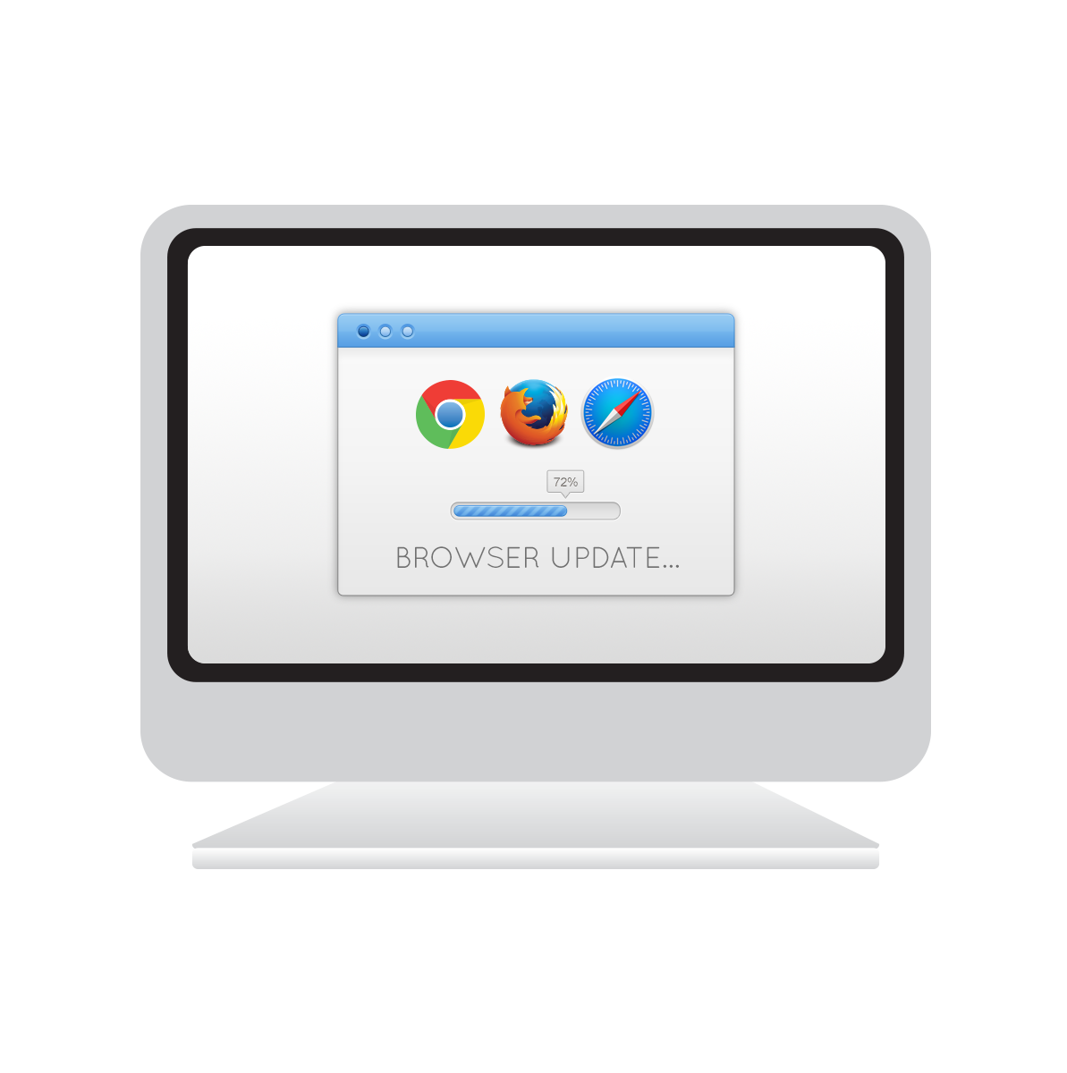
SECURITY UPDATES
Operating System
Internet Browser
Software
Anti-virus
Notes:
This includes your computer or device operating system such Windows or Apple OSX and internet browser such as Google Chrome, Mozilla Firefox, Apple Safari, or Microsoft Internet Explorer or Edge. Even programs such as word processors or tax software will have updates for protection. Many of the updates that address security issues can be scheduled to run automatically, but either way, you will be notified by the program when it is time for an update. All you need to do is follow the instructions.
Equally as important for your protection is creating safe passwords.

Slide 8
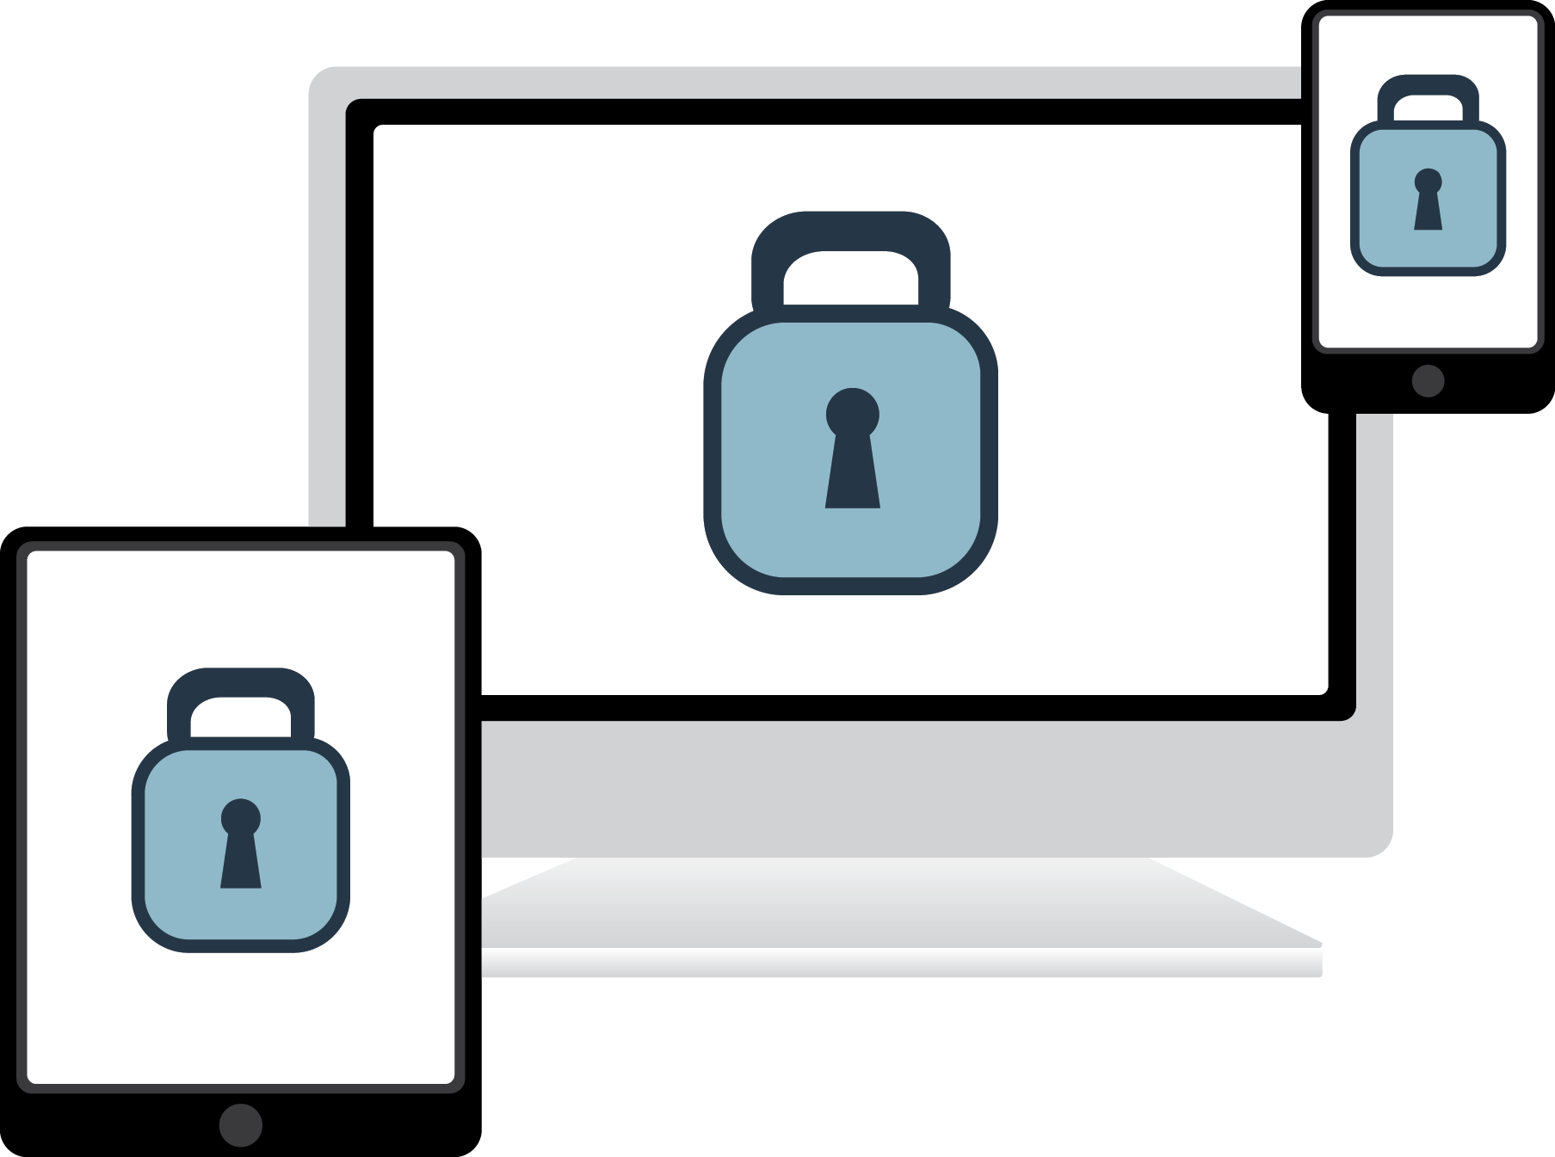
SAFE PASSWORDS
Make it a phrase- the longer the better!
8 character minimum with no repetitive or sequential characters.
No commonly used passwords and no context-specific words.
Use 2-Factor whenever offered.
Make sure passwords are used on all mobile devices and computers.
Notes:
We know how tough it is in today’s cyber world. It seems like every day you hear of another company or bank being hacked. People are hacked everyday too; often, it is due to a poor password. We all have dozens of passwords to remember and the minimum requirements are getting bigger. Passwords used to be just that - a word; and often with only four characters. Now sites and apps require you to have 12 or more characters with numbers, capital letters and symbols.
These password requirements are not going to get shorter or easier so you might want to get ahead of the game. Ever wonder how you can possibly remember all of these passwords while still making them secure?
Make each password a phrase, a saying or even lyrics from a song. Just put all the letters and numbers together and you are on your way to a new “password.”
Do not use: Passwords obtained from previous breaches, dictionary words, repetitive or sequential characters (aaaaa or 123456) and context-specific words like the name or purpose of the site requiring the password.
Remember never to share your passwords. Use passwords on lock screens for all mobile devices and computers.

Slide 9

PASSWORD VAULTS
Store all passwords in a secure location
Don’t have to remember passwords
Notes:
There is one more option when it comes to passwords and that is using software to securely store your passwords for you. There are several companies that provide password vaults that will store your passwords and secret questions. This is very similar to a bank vault - you keep your precious items hidden together and have a key to get in.
As long as you are using a legitimate company, this can be quite safe and easy to use. When you go onto your internet sites like banking or shopping, your username and password fields will be filled in for you after you begin using the vault. Thus, you don’t have to remember your login information. However, you will have a master password in order to use password vaults. This password needs to be very long and secure and more important, you cannot forget this master password as it is your secret key to get in.
You may be wondering how this can be safe! Password vault companies use very advanced techniques to keep your passwords safe like scrambling your passwords on their end so that if anyone does hack the company, the information the bad guys get would be useless to them.

Slide 10
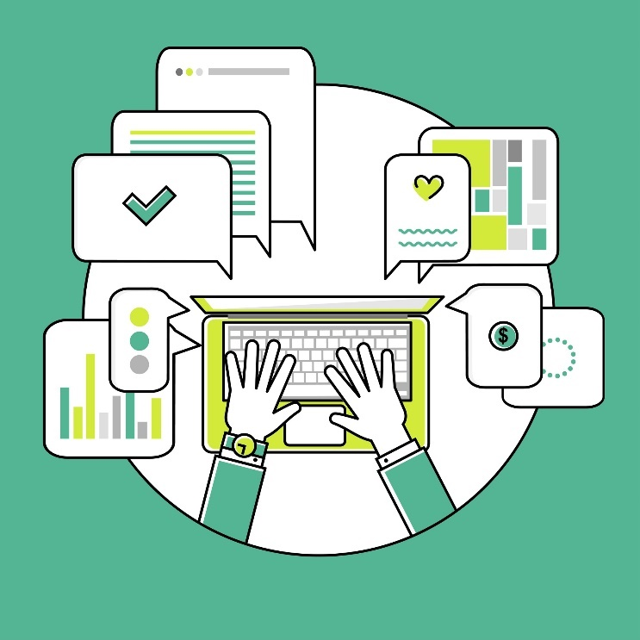
OPEN WIFI
Connect with caution
Do not auto-connect
Avoid banking
Avoid checking e-mail
Avoid making purchases
Notes:
Hackers have gotten pretty crafty in intercepting communications and one of the ways they do it is through open Wi-Fi. Remember, Wi-Fi is wireless internet. If you are in a coffee shop or hotel and you see free, available internet connection, always think twice and use caution. Never have your devices set to auto-connect to open wireless. You can look at these options in your device’s settings. If you’re logging into the internet to check where the closest restaurant is from your hotel or getting directions, that is much safer than accessing the Wi-Fi and logging into sensitive accounts like e-mail, banking, or anywhere that you may input a credit card.
While using Wi-Fi available through a username and password given to you at a hotel is often safer than one without a password, this does not mean that it is always secure enough to access sensitive information. If you must access banking, it is suggested that you use your phone’s internet through your data plan instead of the Wi-Fi.
Even at home, there are a couple of other areas to consider when accessing or providing sensitive information when doing activities online like banking and shopping.

Slide 11
ONLINE SHOPPING AND BANKING
https://www.yourbank.com/
Be sure you are on a real, secure site before entering personal information, including credit card numbers.
Never bank or shop on open Wi-Fi
Banks will not ask for your credit card or password information via e-mail.
Ensure you use strong, unique passwords for financial and shopping sites.
Notes:
There are a few things to always check before entering your login information to get onto a site where personal information including bank numbers and credit cards are going to be used or available. You should always see an ‘S’ after HTTP before accessing sites as the HTTPS means the organization is leveraging encryption for its online transactions . You also will see a little lock symbol after or before the website URL, depending on the browser. Before making a purchase, make sure you can see that little lock. Look around the website before going further. Does something look off to you? Are there no pictures or errors? Check the URL in the internet address bar and make sure you are where you intended to be. If in doubt, pick up the phone and call the company. It is incredibly important to have strong, unique passwords for financial sites or anywhere that your credit card information is stored. If you use the same password for every site, once they figure it out they can simply use it on other sites to access your information.
Banks will never ask for your passwords and financial information via e-mail. This could be a bad guy phishing for information. If you were to receive an e-mail asking for sensitive information and just can’t tell, pick up the phone and call the company. There is no harm in double checking - this is YOUR personal information and you can never be too cautious.
Speaking of caution, lets go over a few common scams and how to identify them.

Slide 12
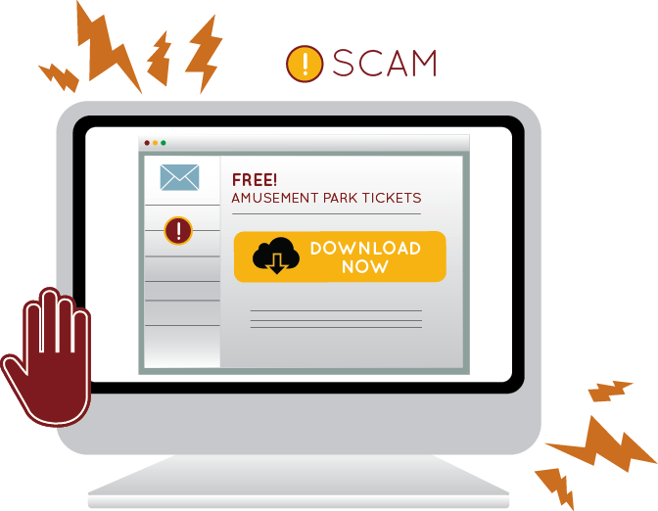
SCAMS
Fake Emergencies
False Promises
Fabricated Prizes
Bogus Investments
Deceptive Money Offers
Phony Lotteries
Notes:
At any given time, there are numerous scams going around the internet. You’ve likely seen or heard a few of these and may have even fallen victim.

Slide 13
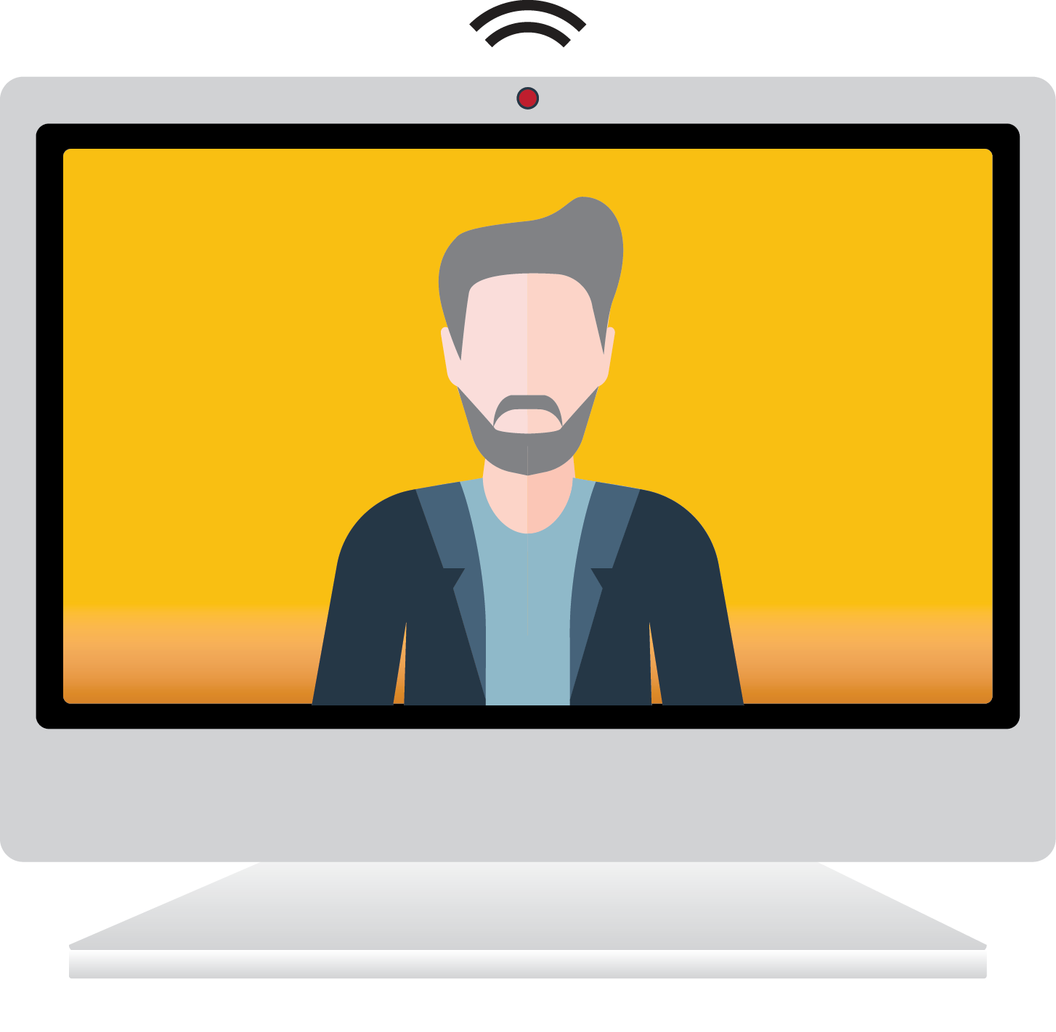
COMPUTER COLD CALLING SCAM
Someone calls and asks to take control of your device to help you.
“Your computer has a virus. I’m calling to help. Please go to our website and download the tool so I can fix it for you.”
Notes:
This one is a mixture of both phone and internet. In this scam, the caller pretends to be from a reputable company that notices something wrong with your computer. They are pretending to call out of concern to help you fix a problem. Their intention is to talk you into giving them access to your computer so they can take it over and steal your personal information. If you receive one of these phone calls, just hang up. You do not need to explain yourself or argue with them, simply hang up the phone; and if you can, block the number.

Slide 14

RANSOMWARE SCAM
A scare tactic that takes control of your device or files; designed to scare you into sending money to get your access back.
WARNING
Your personal files are encrypted. In order to obtain the private key to restore access, you need to pay $300.
Private Key will be destroyed.
Time Left
01: 05: 02
NEXT
Notes:
Ransomware is malware that stops you from using your computer or files until you meet certain demands such as sending money. It can infect your PC from an e-mail attachment or through a bad website.
This is a scam meant to scare you into doing something. Often the ransomware will claim you have done something illegal with your PC, and that you are being fined by a police force or government agency.
These claims are false. It is a scare tactic designed to make you pay the money without telling anyone who might be able to restore your PC.
This is a very serious malware that can prevent you from accessing your operating system like Windows, encrypt your files with a secret key so you cannot access them anymore, or stop applications from running such as your internet browser.
There is no guarantee that paying the fine or doing what the ransomware tells you will give access to your PC or files again. Prevention is the key here with anti-virus and software that you keep updated. If this does happen to you, do not pay any fines; disconnect from internet and run anti-malware scans using your anti-virus; and contact police if you were deceived into paying fines.
It is likely that you may need to have your computer restored to a point before it was infected.

Slide 15
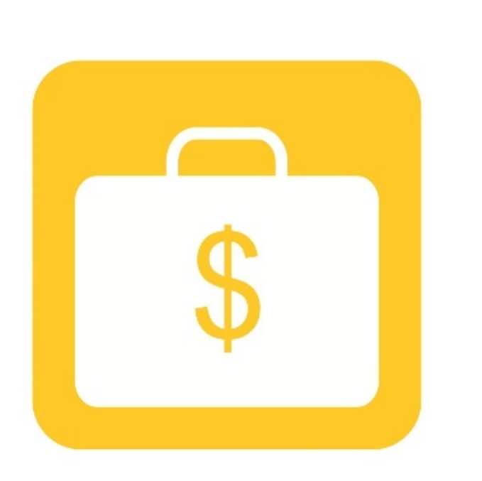
ADVANCED FEE SCAM
Convinces you that in return for sending money in order to help someone, you will receive even more money eventually
“I am a prince and my father left me $40 million in his will, but I have to first bribe government officials to get it out.”
Notes:
This is one that all of you have likely gotten in an e-mail at some point. An advanced fee scam convinces you that in return for helping the scammer, you will get something too. Most of the time this scam promises you very large sums of money for sending them money first to help them access their large sum of money.

Slide 16
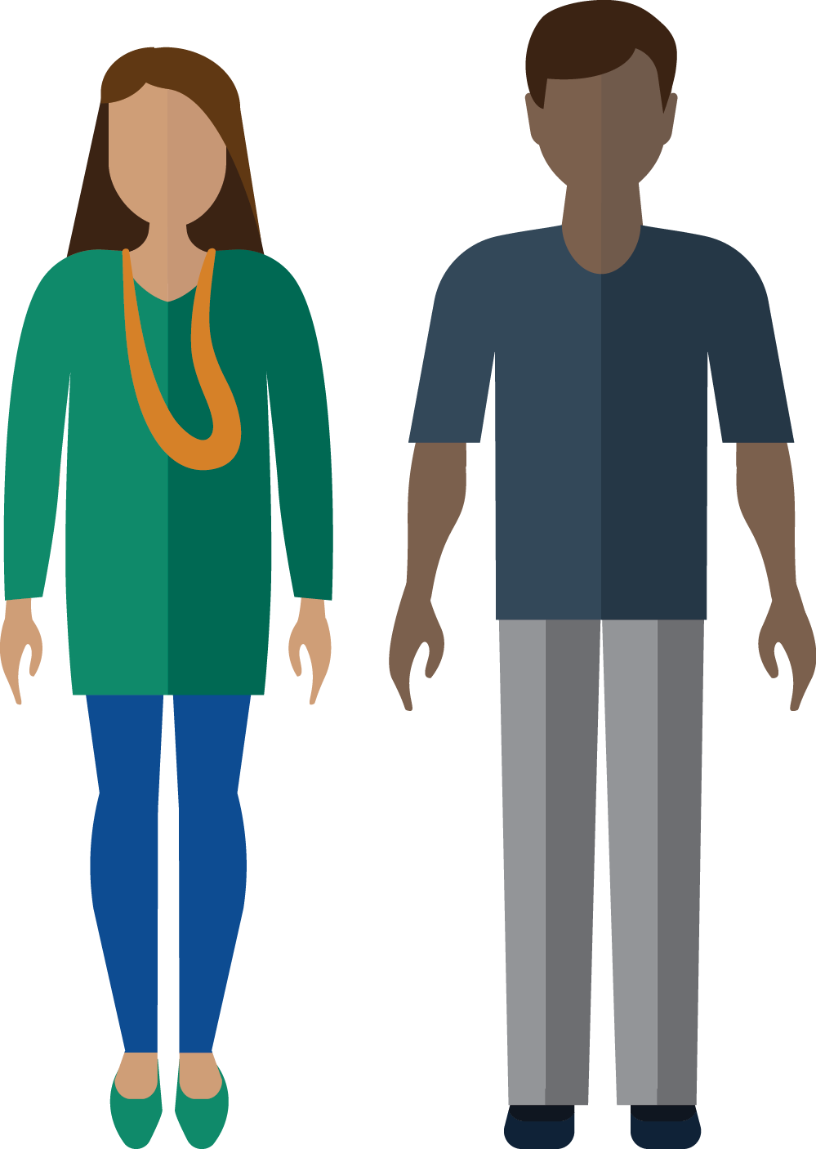
STRANDED TRAVELLER SCAM
Appears to be coming from a family member or a friend, but really is coming from a criminal trying to convince you to send money.
“Please help me! My wallet and has been stolen and if I don’t pay the hotel right now, they will arrest me!”
Notes:
This scam can be tricky because it really pulls at your heartstrings and it’s meant to! In this scam, the criminal will appear to be a friend or family member that desperately needs financial help due to a crisis of some sort. If you receive any e-mail from a desperate family or friend, never reply. Simply call the person and verify if there is a situation and if they need help.

Slide 17
SCAM VICTIM PLAN OF ACTION
Collect your thoughts and remain calm.
Change your passwords.
Make a list of all information that was stolen.
Track all communications.
Obtain a copy of your credit report and review it.
Notify credit card companies and financial institutions.
Contact your local law enforcement.
Notes:
If you do realize that you’ve become a victim, here are some steps to help remedy the situation. First, collect your thoughts and remain calm! Next, you will want to go through all of your accounts whether you believe they have been compromised or not and change your passwords. Make a list of all information that you believe was stolen and that you unknowingly gave to the criminal. Track all of the communications, especially if the scammer is still trying to exploit you. Depending on where you are located, obtain a copy of your credit report or confidential financial records and review them. Notify all credit card companies and financial institutions about the situation and they will advise you. Finally, contact your local law enforcement. Remember, these scammers are criminals and what they are doing is against the law.

Slide 18
SAFE EMAIL HABITS
Never follow links or instructions from unknown or untrusted sources
Never send sensitive information through e-mail
Log out when you are finished
@
Notes:
Even if you should open an e-mail from someone or an organization you know, you still need to be cautious. Learn how to use your anti-virus software to check attachments before you open them. For websites linked in e-mails there are a couple of tips. Hover over the website URL in the e-mail, you then will see the real URL. Never click - just hover with your mouse pointer. You may also copy and paste the URL directly to another tab on your web browser. Hopefully you will be looking at the authentic website that you intend to see. The main idea is to avoid clicking on website links directly from e-mails.
All of your e-mail is stored somewhere on some server some where in the world. Even though you delete e-mails in your e-mail account, you have absolutely no comfort the e-mail you sent is removed from who you sent the e-mail to or any server the e-mail traveled en route. Thus, be very discreet about any personal information you send, whether to family, friends, businesses, etc.
Here are a couple of quick tips to remember:
Do not follow links from unknown or untrusted sources
Be careful about what personal information you share
Do not reply to posts or e-mail messages when asking for personal information
Do not send sensitive information through e-mail
Log out when you are finished

Slide 19
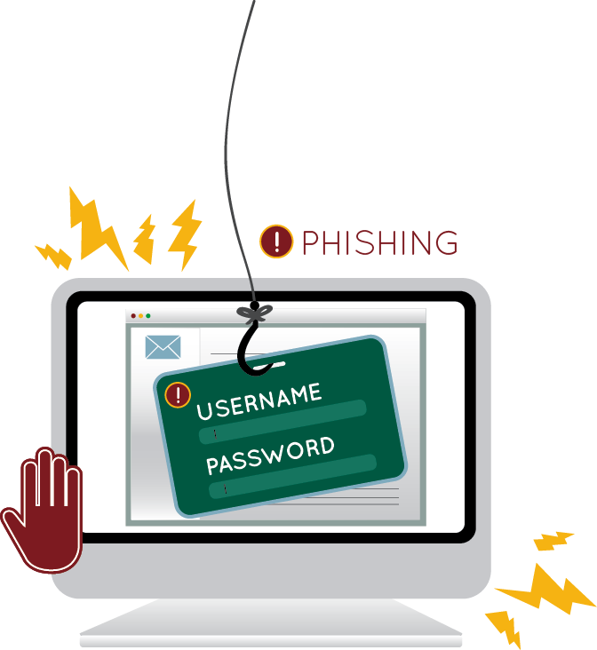
PHISHING
A malicious attempt to acquire sensitive information by pretending to be a trustworthy source and using fake bait to catch victims.
Notes:
Phishing is a type of scam in its own right; it is where a person posing as a bank, lawyer, widow, or ill person asks you to help them with money, inheritance, validating your password or lottery winnings. People who have responded to these requests lose thousands of dollars every year. Often, these can be very deceptive and look real - but remember - nothing is free and your bank does NOT need you to confirm passwords or credit card numbers via e-mail for your security.
Lets see an example.

Slide 20
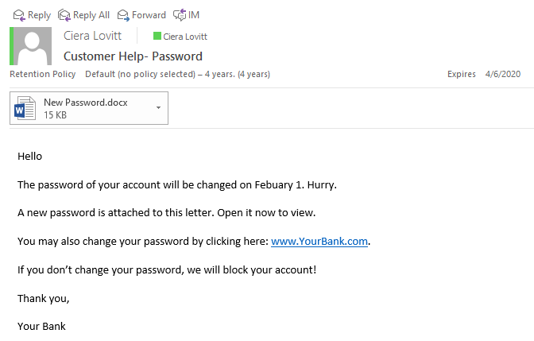
PHISHING EXAMPLE
Best Bank
customer5319
http://NotYourBank.com
Ctrl+Click to follow link
Notes:
While many phishing e-mails are getting sophisticated and can be hard to tell from a legitimate e-mail, there are usually a few signs that it is false such as poor grammar, hyperlinks that do not match the real URL, spelling mistakes, odd attachments, threats, no logo or wrong logo, or an extreme sense of urgency to do something like click something, open an attachment, or reply. You’ll notice in this phishing e-mail example several of these signs.
The best precaution for safe e-mail use is not to trust or respond to anything that you do not know is safe. Many attacks are hidden as e-mails offering jobs, lottery winnings, or asking for assistance in moving money. These are extremely dangerous, illegal, and often lead to great loss by the person that responds to the e-mail. Just delete such e-mails, never open the attachments, and do not respond to requests to send such messages on to your friends and family. Remember - your bank will never ask you to log in or provide your account information or password through an e-mail!
Remember, even if the e-mail looks like it’s coming from a person that you know, even family, it’s possible their e-mail account was hacked and the bad guys are sending e-mail through it.

Slide 21
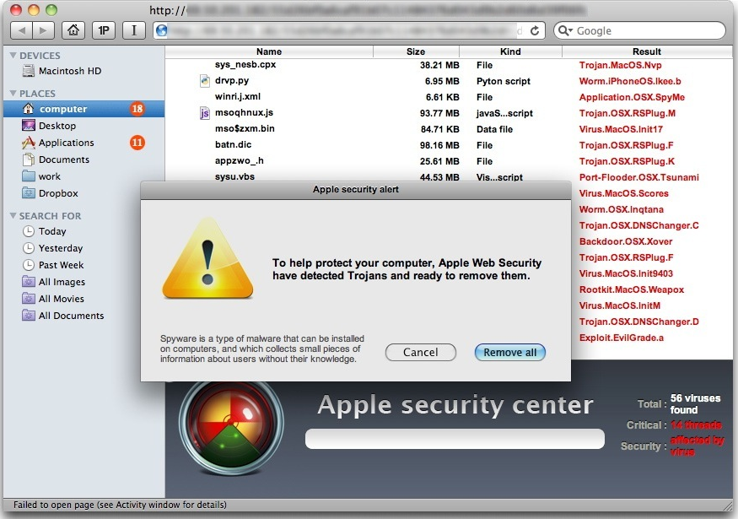
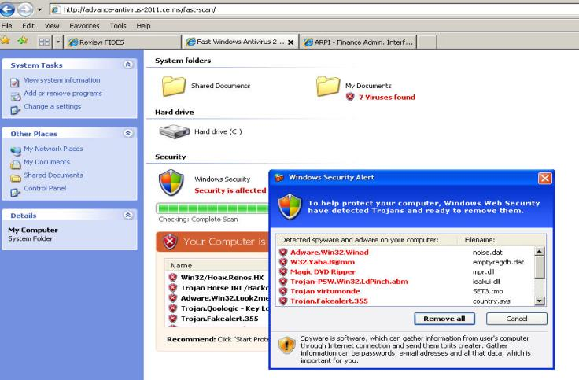
QUESTION WHAT YOU SEE
Notes:
Sometimes in surfing the web, the bad guys will use pop-ups or malicious advertisements to make you believe your computer has become infected. These are in fact not warnings from your computer but are designed to look like alerts to make you click on them, which will then cause harm to your computer.
Your real anti-virus will not have a URL across the top. If you run into this kind of pop-up, do not click it and close your browser. If you’d like to be sure, simply use your real anti-virus to run a scan of your computer.

Slide 22
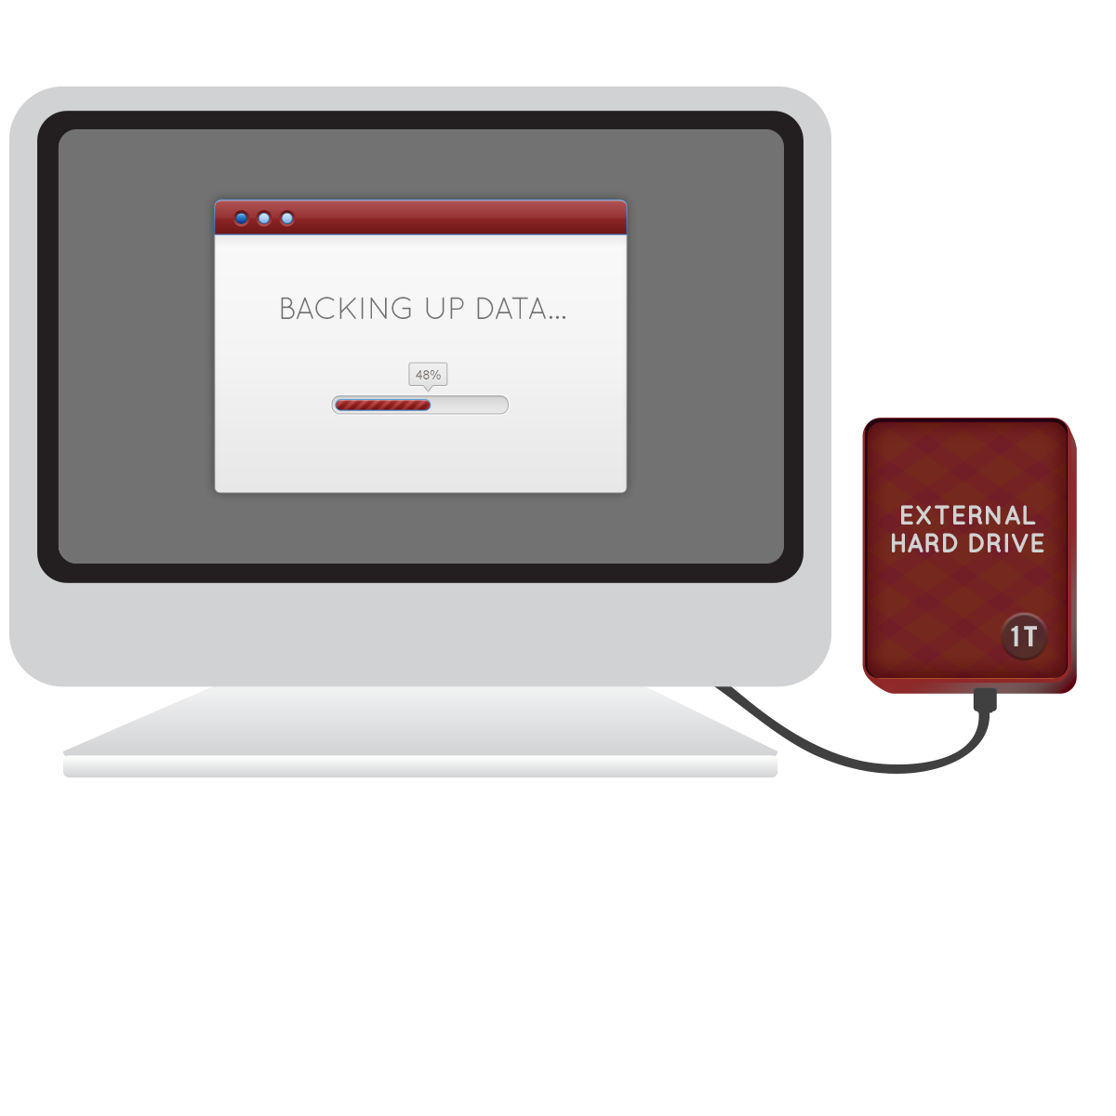
BACK UP YOUR DATA
This is extremely important—but, easy to do.
Use an external portable storage device or cloud services
Backup your data daily or weekly
Notes:
Back-up your data! Computers crash and phones and devices break and get lost. Simply use an external portable storage device or reputable cloud service to back-up everything important to you. If you do stumble across something and make a mistake infecting your computer, you’ll still have your important family photos and documents backed up externally.

Slide 23
DOWNLOADS AND STREAMING
Use reputable sites only:
Download music
Watch movies
Download apps
Stream television
Play games
Notes:
One of the greatest things the internet has brought to us is endless entertainment! We have more options than ever when it comes to watching a favorite TV show or streaming a movie for the whole family to enjoy. There are plenty of safe ways available, but they all require you to use a reputable site such as Pandora, Netflix, Hulu, and other named brands. You’ve probably heard of these or know of others.
You never want to search the internet for music or movies and download what you find in the search results. This is extremely dangerous and will open your computer to malware - not to mention that it could be illegal due to copyrighting and other intellectual property rights’ laws.

Slide 24
SOCIAL MEDIA
Get permission before posting pictures of others
Do not put sensitive information on social media
Do not post that you are going out of town
What goes on the internet, stays on the internet
Notes:
Social media is a wonderful way to stay in touch with family and friends! Just remember that was goes on the internet, stays on the internet! Even if you actively delete a post, it is never fully deleted from the internet. Never post personal information on social media or sensitive information like going out of town. Remember to get permission before posting pictures of others as they may not be as keen to have their picture on the internet. Let’s go over some tips for safe picture posting.

Slide 25

PICTURES
Stop and Think before posting pictures - Does this reveal personal information?
Do not post pictures while still on vacation
Look in the background of photos too
Deactivate geotagging from your photos
Notes:
Unfortunately, even the most innocent of intentions can give predators dangerous details. Posting pictures can reveal information such as a home address, a car plate, or even your children or grandchildren’s school. Even street signs, school jersey/sweatshirts, posters, etc. in the background view of a picture can give a criminal information. Posting pictures while still on vacation lets a criminal know that you aren’t home.
On top of pictures that plainly give away too much information, even trickier is the information that you may be giving away without knowing it through photo geotagging. Geotagging is the process of embedding the exact geographic coordinates of where a picture was taken with a smart device, such as a cell phone, tablet, camera or other device that has a location service. If a person posts or shares a picture that was geotag enabled, anyone viewing that picture can see the exact location of where that picture was taken – the address of the house, school or vacation spot where you or a family member is located.
This can be turned off but you need to be careful when doing so.

Slide 26
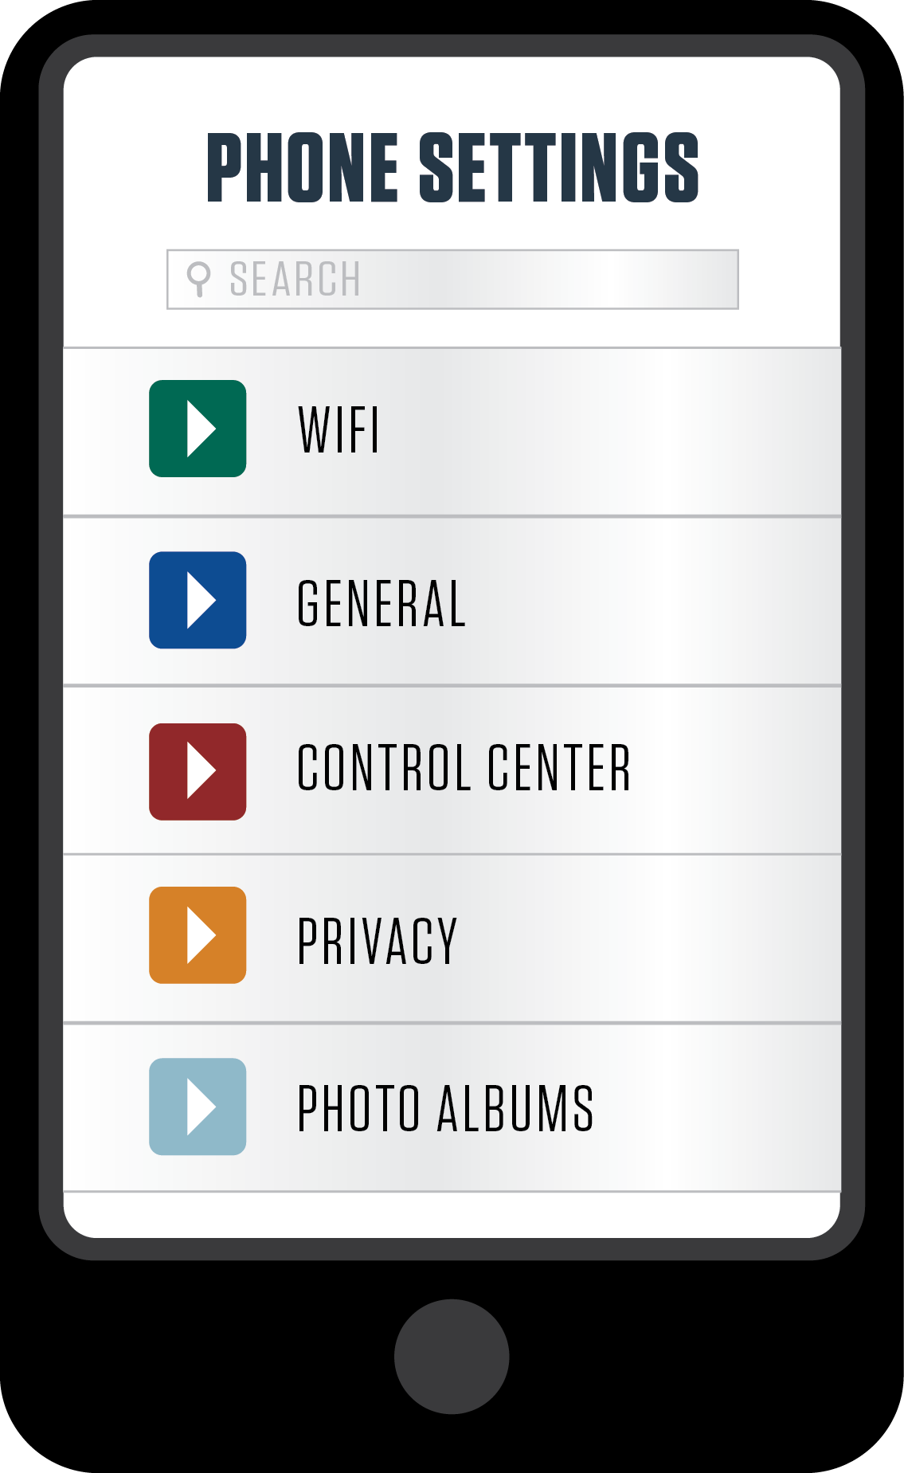
DEACTIVATE GEOTAGGING
Only deactivate geolocation from pictures
Leave other geolocation apps and services in place
Check with your cellphone provider for instructions on how you can change the setting on your specific device
Notes:
Because many location services can also tell emergency services or family members where you are located, you should only deactivate geolocation from pictures. Leave other geolocation apps and services in place. Check with your cellphone provider for instructions on how you can change the settings on your specific device.

Slide 27
RECAP: TOP TIPS
1. Think before you click.
2. Get anti-virus protection and keep it updated.
3. Keep your computer software and device apps updated.
4. Back-up your pictures and documents.
5. Create strong, unique passwords for every site.
6. Be careful on public Wi-Fi connections.
7. Question what you see in e-mails and pop-ups.
8. Download and stream from proper sites only.
9. Do not post sensitive information on social media sites.
10. Be mindful of e-mail and phone call fraud attempts.
Notes:
Top Tips:
Think before you click.
Get anti-virus protection and keep it updated.
Keep your computer software and device apps updated.
Back-up your pictures and documents.
Create strong, unique passwords for every site.
Be careful on public Wi-Fi connections.
Question what you see in e-mails and pop-ups.
Download and stream from proper sites only.
Do not post sensitive information on social media sites.
Be mindful of e-mail and phone call fraud attempts.

Slide 28




www.IAmCyberSafe.org
@IAmCyberSafe
@IAmCyberSafe
@Center for Cyber Safety and Education
@ISC2Cares
© 2018 Center for Cyber Safety and Education, a 501(c)(3) segregated fund of (ISC)², Inc. Permission granted to reproduce for personal and educational use only. Commercial copying, hiring, lending is prohibited.
Notes:
Thank the audience for their time and invite any questions.

